Slide 1
Natural Catastrophe Events Pipeline
Bhargav Chhaya,18-04-2025.

Slide 2
Problem & Data
Goal: Assign each headline to one of five natural disaster types.
Scope: Only include titles reporting real events, not forecasts or commentary.
Five Hazard Categories:
Earthquake: Ground shaking from tectonic activity
Flood: Water overflowing onto land
Volcano: Eruption of lava, ash, and gases
Tornado: Spinning column of wind touching ground
Wildfire: Uncontrolled fire spreading through vegetation

Slide 3
Dataset description and loading
Objective: Loaded the 'Nat Cat Events.csv' dataset using the Python pandas library. Method: Employed the read_csv function, specifying UTF-8 encoding for broad character compatibility.
Outcome: Successfully imported the data into a DataFrame structure for analysis.
Dataset Size: The loaded dataset contains 91,479 rows (entries).Data Features: Includes 8 columns: url, url_mobile, title, seendate, socialimage, domain, language, sourcecountry.

Slide 4
Task 1 : Exploratory data analysis methodology
Initial Structure Check: Reviewed DataFrame columns, data types, and non-null counts using .info().
Missing Value Analysis: Calculated and visualized the percentage of missing values for each column using .isna().mean() & .plot.barh()).
Headline Length Feature: Engineered a title_len column by calculating the character count for each entry in the title column.
Headline Length Analysis: Assessed the distribution of title_len using descriptive statistics (.describe()) and histogram visualization (.hist()).
Temporal Range Definition: Parsed seendate text into datetime objects (pd.to_datetime) and extracted the minimum/maximum dates to define the dataset's time span.

Slide 5
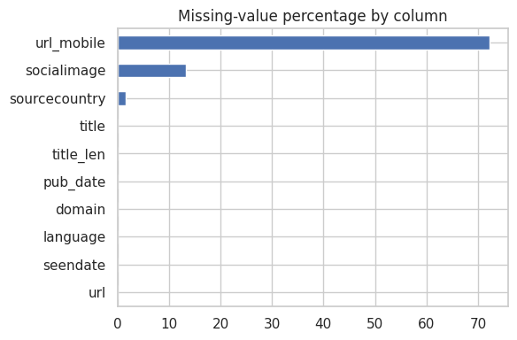
Task 1 : Exploratory data analysis key findings
Missing Data: url_mobile (>70%) & socialimage (~15%) incomplete; sourcecountry (<2%) mostly full. Core columns look complete.

Slide 6
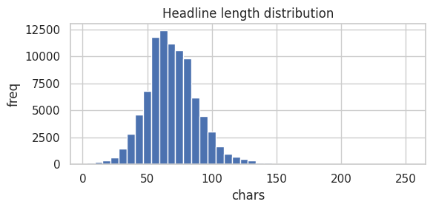
Task 1 : Exploratory data analysis key findings
Headline Length: Typical range 30-110 chars, peaking at 55-75. Extreme lengths rare.
Time Span: Data covers one year: Jan 1, 2024 (00:00) - Jan 1, 2025 (00:15).

Slide 7
Task 2 : Data cleaning methodology
Drop null & duplicate titles:Remove any rows missing a headline and dedupe to ensure one title per article.
Baseline regex filter:Keep only titles containing a natural‑hazard keyword (e.g. “earthquake,” “flood”), a past‑tense verb (e.g. “struck,” “reported”), and a simple location pattern; exclude known junk phrases.
spaCy NER gate:Apply spaCy’s pretrained GPE/LOC model to each title and retain only those with a true place entity.
MiniLM semantic filter:Encode titles and a small set of “real event” seed sentences with MiniLM; require a cosine similarity ≥ 0.45 to ensure genuine disaster reports.
Transparent, staged pipeline:Log the row count after each stage, enabling clear precision‑vs‑recall trade‑off analysis.

Slide 8
Task 2 : Data cleaning results
Raw headlines: 91 479 → titles non-null: 91 384 → unique: 91 269
After baseline regex: 5 268 titles retained (~5.8 % of raw)
After spaCy NER: 3 350 titles retained (−36 % of previous)
After MiniLM cosine: 2 869 titles retained (−14 % of previous)
Impact on clustering: silhouette on MiniLM embeddings rose from ~0.21 (raw) to ~0.46 (cleaned), dramatically improving cluster cohesion and downstream model quality.

Slide 9
Part 2 : Feature Engineering
TF‑IDF (Lexical Features)
Extract uni‑ and bi‑grams from cleaned titles (min_df=3, English stop‑words)
Result: 2 869 × 1 838 sparse matrix of term weights
MiniLM Embeddings (Semantic Features)
Use all‑MiniLM‑L6‑v2 to encode each title into a 384‑dim dense vector
Captures context, paraphrase, and nuance beyond simple term counts
Complementary Strengths
TF‑IDF → interpretable top‑term analysis for cluster labeling
MiniLM → contextual clustering with higher semantic cohesion
Empirical Validation
K‑Means(k=5) silhouette: TF‑IDF = 0.053 vs MiniLM = 0.145
Demonstrates significant gain in cluster quality using embeddings

Slide 10
Part 2 :Clustering and selected model
Methodology :Evaluated K‑Means, Agglomerative, Spectral, and HDBSCAN on both TF‑IDF and MiniLM feature spaces.Benchmarked all models using Silhouette (higher = better cohesion) and Davies–Bouldin (lower = better separation)
Best performing models : HDBSCAN (min_cluster_size=80) achieved the top Silhouette of 0.229 but left ~10 % of headlines unlabeled.
AgglomerativeClustering (average linkage, k=5) delivered Silhouette 0.178 with 100 % coverage.
Selected: AgglomerativeClustering(n_clusters=5, linkage='average') to produce exactly five fully‑labeled hazard groups.

Slide 11
Key results
Cleaned 91479 raw headlines down to 2869 verified event titles.MiniLM embeddings (384 d) outperformed TF‑IDF (1838 d) in clustering.
Evaluated K‑Means, Spectral, Agglomerative, and HDBSCAN; used silhouette & Davies–Bouldin for fair comparison.
HDBSCAN (min_cluster_size=80) gave top cohesion (sil 0.229), but Agglomerative (average linkage, k=5) ensured 100 % coverage with sil 0.178 as cluster size 80 was only classifying 3 clusters .
Final pipeline uses AgglomerativeClustering(n_clusters=5, linkage=average) to assign every title to one of the five hazards.

Slide 12
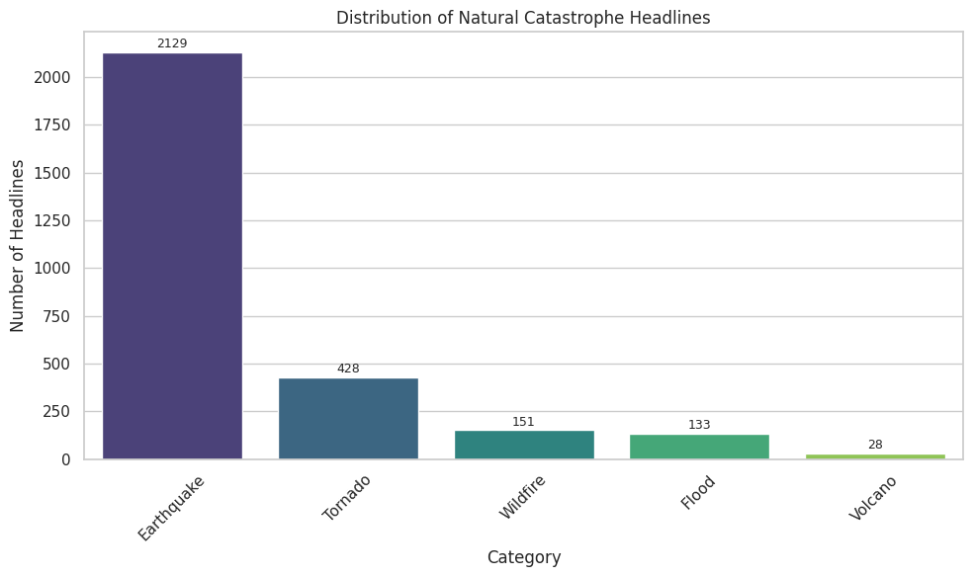
Headline Distribution by Hazard Category
Earthquakes dominate our cleaned dataset with 2 129 headlines (~74 % of total).
Tornadoes come next at 428 headlines (~15 %).Wildfires and Floods have 151 (~5 %) and 133 (~4 %) headlines respectively
.Volcanoes are least frequent with 28 headlines (~1 %).

